Slide 1
HR Analytics Dashboard presentation

Slide 2
agenda
Problem statement
Overview of HR metrics and dashboard purpose
Attrition analysis by gender and age band
Attrition trends across education fields
Department-wise attrition insights
Employee distribution by age group
❓ Q&A and discussion

Slide 3
Problem statement
Analyze HR data to understand employee attrition patterns across key dimensions. Visualize metrics like employee count, attrition rate, and demographic breakdowns. Explore attrition trends by gender, age group, education field, and department. Create an interactive Power BI dashboard to support data-driven HR decisions.

Slide 4

Title: HR Analytics Dashboard Subtitle: Employee Attrition Analysis

Slide 5
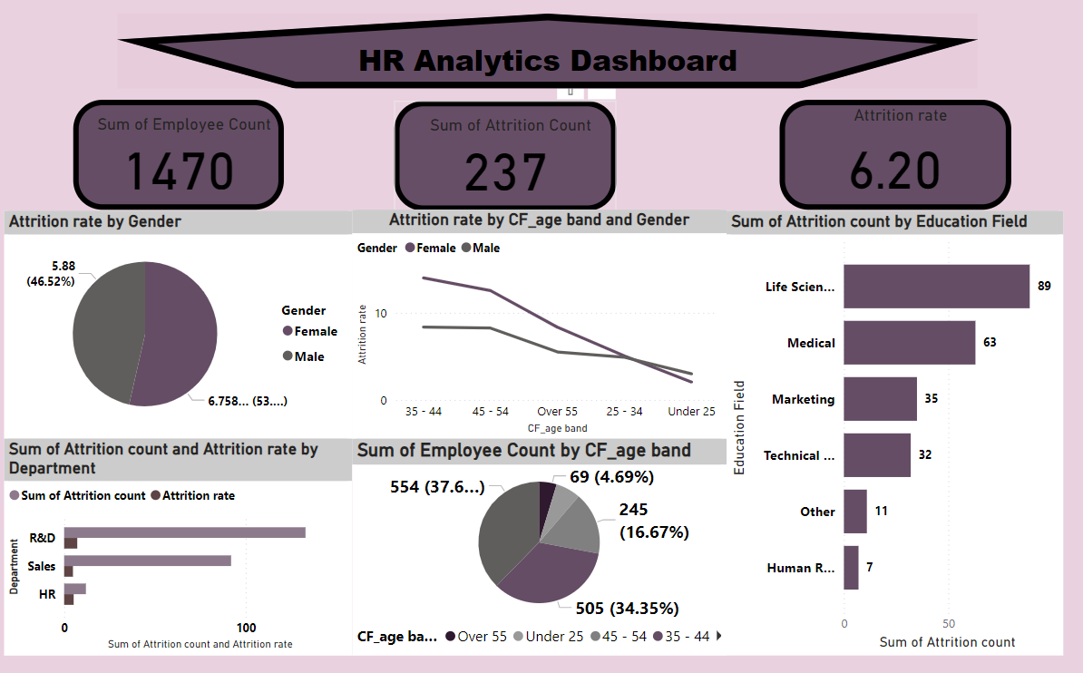

Slide 6

Key Metrics:
👥 Total Employees: 1470
🔄 Total Attrition: 237
📉 Attrition Rate: 6.20%
Objective: Identify patterns and drivers of employee attrition to inform HR strategy.

Slide 7
Attrition by Gender & Age Band
Gender Breakdown:
Female: 5.88% (46.52%)
Male: 6.75% (53.48%)
Age Band Trends:
Under 25: Higher attrition in both genders
25–34 & 35–44: Moderate attrition
Over 55: Lowest attrition
Visuals: Line chart + bar chart

Slide 8
Attrition by Education Fiel
Top Fields by Attrition Count: | Education Field | Attrition Count | |---------------------|-----------------| | Life Sciences | 89 | | Medical | 63 | | Marketing | 35 | | Technical | 32 | | Other | 11 | | Human Resources | 7 |
Insight: Life Sciences and Medical dominate attrition numbers.

Slide 9
Department-wise Attrition
Departments:
R&D
Sales
HR
Insight: Sales and R&D show
lowest
Metrics:
Attrition Count
Attrition Rate
significant attrition; HR has the

Slide 10

Employee Distribution by Age
Age Band Breakdown: | Age Band | Count | % of Workforce | |------------|-------|----------------| | Under 25 | 245 | 16.67% | | 35–44 | 554 | 37.59% | | 45–54 | 505 | 34.35% | | Over 55 | 69 | 4.69% |
Insight: Majority of employees are between 35–54 years.

Slide 11
Summary & Recommendations
Key Takeaways:
Male attrition slightly higher than female
Life Sciences & Medical fields need retention focus
Sales & R&D departments show elevated attrition
Younger employees more likely to leave
Recommendations:
Targeted retention programs
Age-specific engagement strategies
Departmental deep dives

Slide 12

Q&A..

Slide 13
Thank you

